Slide 1









Seashell Rarity Predictor
PRESENTATION 2026
Student Name
Student Email
Guide
Kashish Rathod
Siddhi Kangutkar
rathod.kashish@universal.edu.in
siddhikangutkar2@gmail.com
Mr.Lokesh Chakranarayan

Slide 2

OUTLINE
Abstract of the Project
Problem Statement
Proposed Solution
System Architecture
Live Demo of the Project
Embedded Video of Project
Conclusion
Future Scope

Slide 3
Abstract
The Seashell Rarity Predictor is an AI-based system designed to classify seashells and estimate their rarity using machine learning techniques. The project helps researchers, collectors, and marine enthusiasts identify uncommon shell species quickly and accurately. By using a trained model and feature-extraction methods, the system predicts rarity levels based on visual, structural, and morphological characteristics of uploaded shell images.

Slide 4

Problem Statement
Identifying seashell species and determining their rarity is traditionally a manual and time-consuming task requiring expert knowledge. Due to the vast variety of shells and their subtle differences, non-experts often struggle with proper identification. There is a need for an automated system that:
Recognizes seashell types from images
Predicts their rarity level
Assists researchers and hobbyists with reliable classification

Slide 5

Proposed Solution
The proposed solution uses a deep learning model trained on a dataset of seashell images. The system:
Accepts an image captured or uploaded by the user
Preprocesses the image (resizing, normalization, noise reduction)
Extracts key features using a CNN-based architecture
Classifies the shell type and predicts rarity (common, rare, very rare)
Displays results through an interactive interface
This approach provides fast, accurate, and user-friendly seashell rarity analysis.

Slide 6
System Architecture
2. Preprocessing Module:
1. Input Layer:
User uploads or captures a seashell image.
Image noise removal, normalization, and resizing.
3. Feature Extraction (CNN):
4. Classification Model:
Convolutional Neural Network extracts shell pattern, shape, color, and texture.
Trained neural network predicts shell category and rarity.

Slide 7
System Architecture
5. Output Layer:
6. Front-end Interface:
Displays species name, rarity score, and probability.
Provides user-friendly interaction for uploading images and viewing results.

Slide 8



Live Demo of Project
Here’s the list of some demo of the projects -
Demo 1
Demo 2
Demo 3
Rarity, confidence, shell identification.
Real-time image upload
Processing and classification

Slide 9
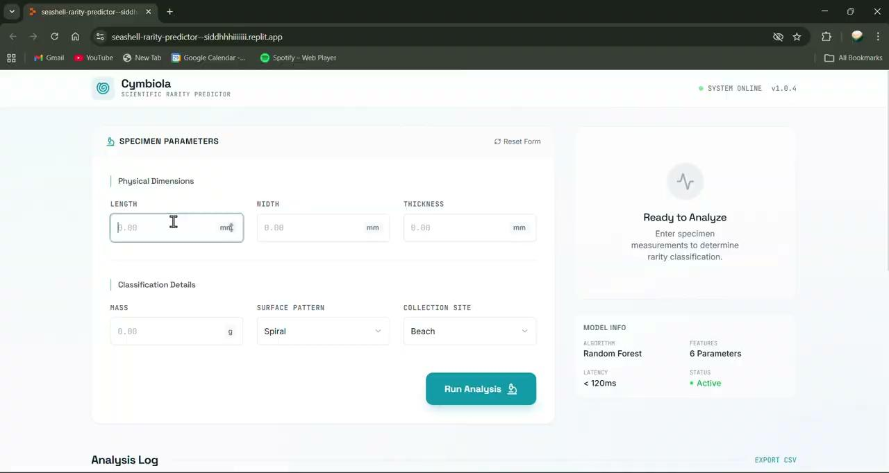
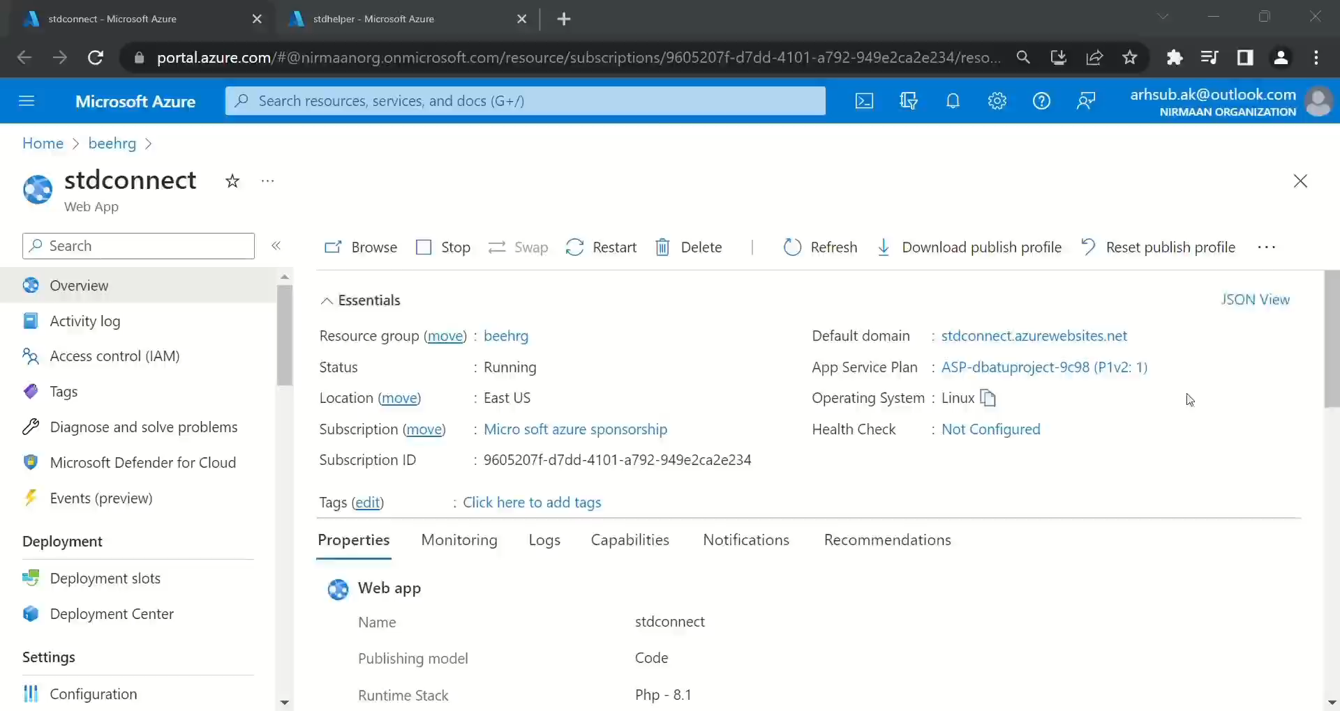
Video of Project Demo

Slide 10

Conclusion
The Seashell Rarity Predictor successfully automates seashell identification using machine learning. It delivers accurate rarity predictions and provides a convenient solution for marine researchers and collectors. The system reduces dependency on manual expertise and speeds up identification processes.

Slide 11

Future Scope
Expand dataset with more seashell species
Improve accuracy with advanced deep learning models (e.g., Vision Transformers)
Add mobile app support with offline prediction
Integrate geolocation for mapping shell occurrences
Provide conservation status and ecological insights

Slide 12
Thank You
Notes:
thank you very much for joining this PPT, keep learning.
‹#›

